Slide 1
爱拼才会赢
No pain no gain
Post-Reading

Slide 2
Learning Objectives:
Use graphic organizer to organize the text to understand the whole text
Answer literal and inferential questions regarding the text
Summarize the text in a Cloze activity.
Improve fluency from reading aloud exercise.
Compare two texts to find similarity and differences

Slide 3
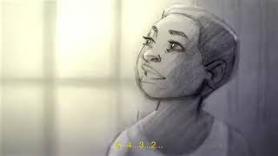
Warm up: watch the video 亲爱的篮球

Slide 4
Task 1: Review/summarize the story of Lin Dan
time 什么时候 | what 林丹做什么
小时候
五岁的时候
九岁的时候
十二岁的时候
2002年的时候

Slide 5
Give a new title for Lin Dan’s story
A. 林丹小时候
B. 林丹的爸爸妈妈
C. 超级丹
D. 林丹很辛苦

Slide 6
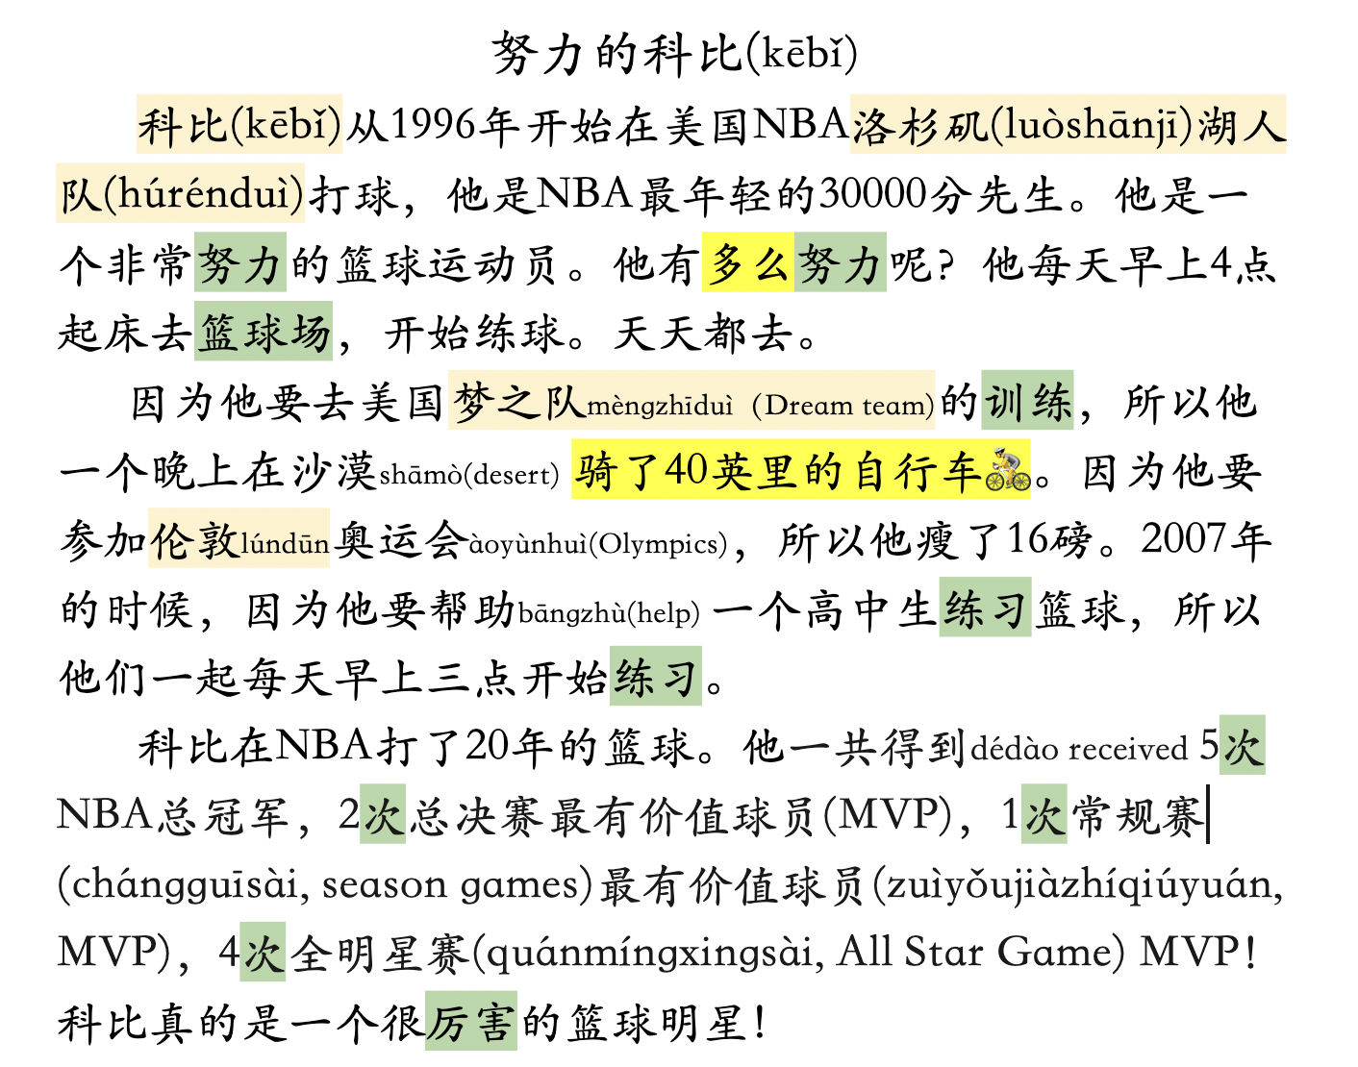
Task 2: Parallel Reading - Read 科比

Slide 7
Task 2: Parallel Reading - Answer questions to show your understanding.
科比有多么努力？Find the evidence in the text. Check the ones that applies
是/不是 | 科比从1996年开始在洛杉矶湖人队打球。
是/不是 | 他是NBA最年轻的30000分先生。
是/不是 | 他每天早上四点起床练球。
是/不是 | 他一个晚上骑了四十英里的自行车。
是/不是 | 因为他要参加伦敦奥运会，所以他瘦了16磅。
是/不是 | 他和一个高中生每天早上三点开始练球。
是/不是 | 科比在NBA打了20年的篮球。

Slide 8
Task 2: Parallel Reading - Answer questions to show your understanding.
2. ________ How many times has Kobe won MVPs throughout his NBA career? (一）4 times（二）2 times (三）one time (四）12 times
3. ________ 洛杉矶(luòshānjī) is (一）San Francisco （二）Houston (三）Los Angels (四）Chicago
4. ________ "努“ 的部首bùshǒu (一）女（二）力 (三）刀 (四）又
5. Can you find a statement each from 林丹 text and Kobe text to show that the two athletes are both amazing.
6. ________ 努力 is similar to (一）不放弃 （二）太累了 (三）厉害
7. 你喜欢打球吗？你喜欢打什么球？
林丹
科比

Slide 9
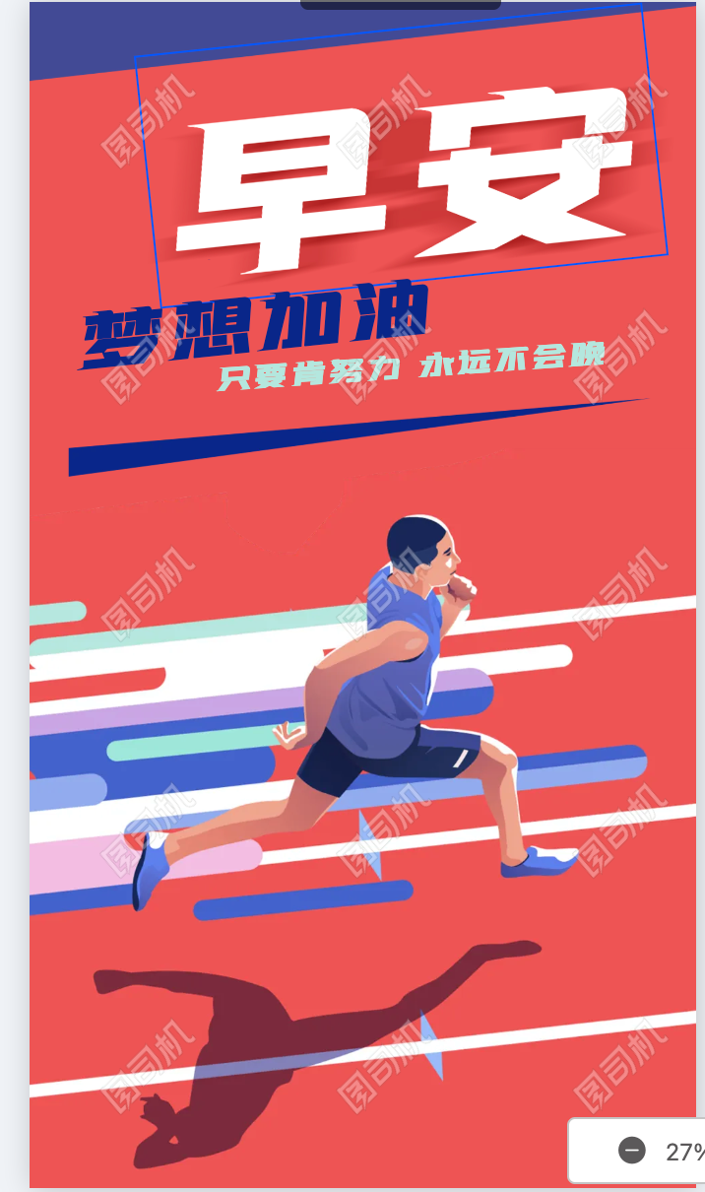
Task 3
Design a motivational poster
Presentational writing
Design a post that will inspire your friends to reach their goals. Use the vocabulary/patterns you have learned in this unit. In the post, suggest a goal for your friend, what to practice, and how much time to practice each day. Write some encouraging words to help your friend accomplish the goal.

